Slide 1
GERAS
Abdelmounaim DEBIECHE

Slide 2
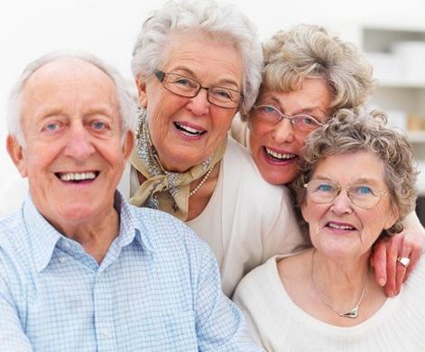
Ageing People
Well-being of ageing people: independent, active, happy, healthy, safe, …

Slide 3
Societal Challenges of ageing people
Worldwide population is aging (by 2050 over 20% of the population will be aged 65 or over )
- uneven demo-graphic composition
- increase in age related illness
- It places additional burdens on healthcare provision
- the amount of informal support available will decrease due to a reduction in the ratio of working age people (15-64) to those older than 65.
Joseph Rafferty et al., 2013

Slide 4
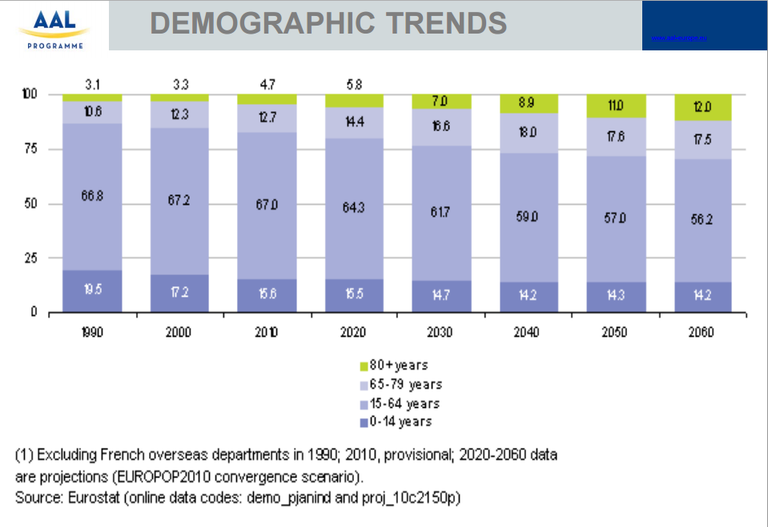
Demography of ageing people

Slide 5
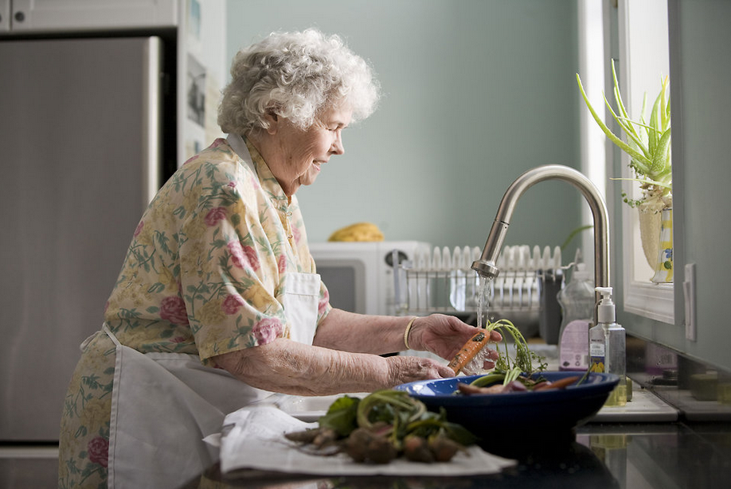
Ageing People
Living actively and independently at home
Most older adults prefer to remain in the home of their choice as long as possible
Older adults face challenges related to coping with daily life activities and making decisions when they live independently, especially when living alone.
Elisabete Pires, AAL 2015, Brussels

Slide 6
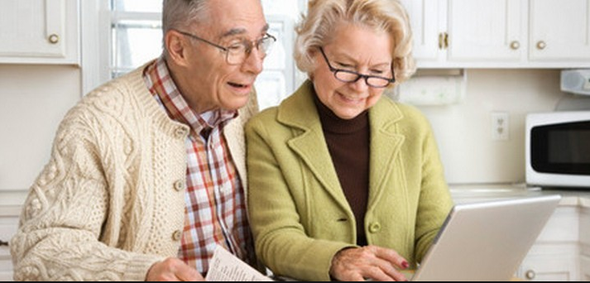
Ageing People
ICT as an enabler for older adults to achieve their full capacities to stay active and live independently
- estimated wealth of Europeans above 65 have
3 billon € of revenues and wealth
- it can also be considered as a socio-economic opportunity at large.
Elisabete Pires, AAL 2015, Brussels,
Rafael De Andrés Medina AAL 2015, Brussels

Slide 7
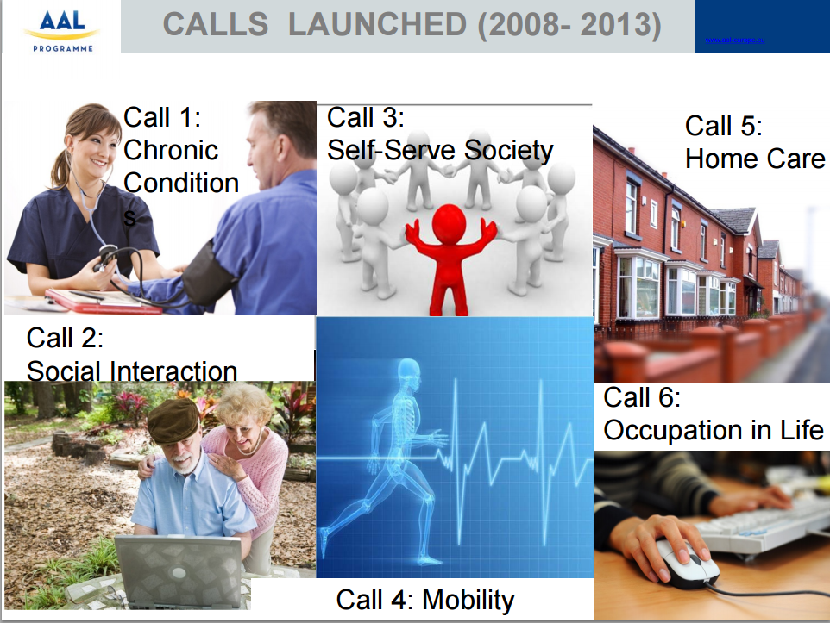
Différent Solution for Ageing people

Slide 8
Different Solutions for Ageing People

Slide 9
Agenda
Internet Des Objets
Titre2
Titre3
Titre4
Notes:
I will provide a broad overview of ThingML, present some challenges and interesting features that are missing in ThingML and suggest some potential contributions of our own.

Slide 10
Internet Des Objets

Slide 11
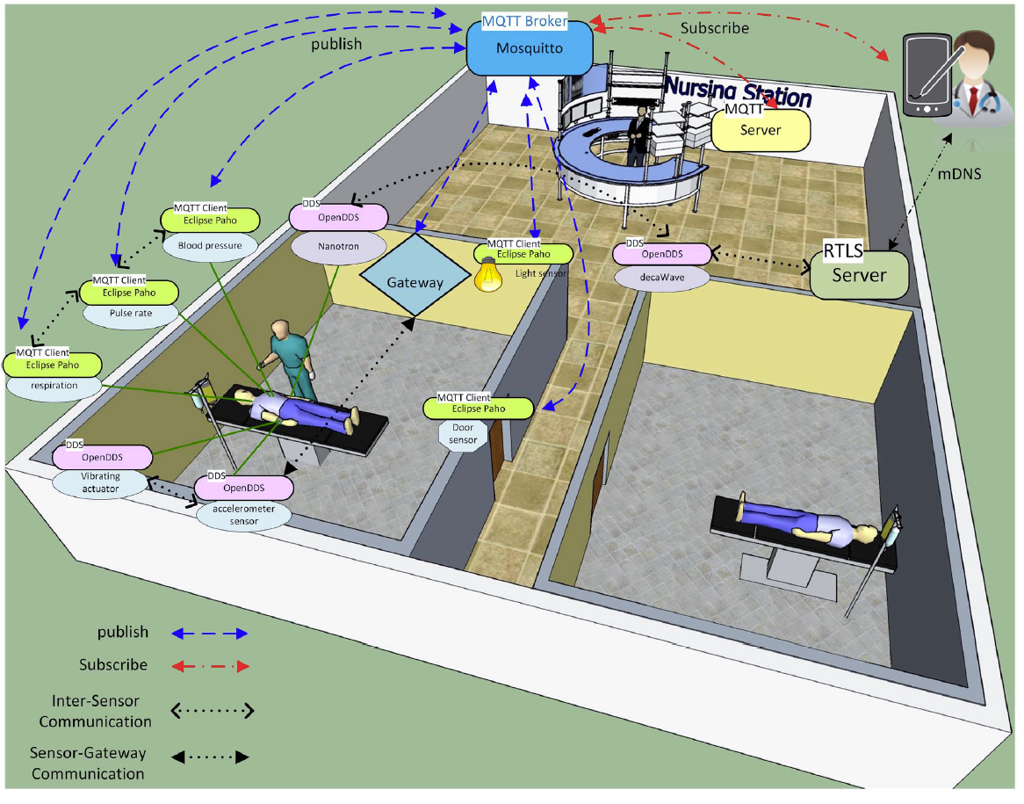
Internet Des Objets

Slide 12

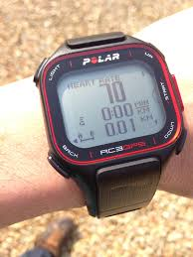
Object Abstraction
The first layer, the Objects (devices) or perception layer, represents the physical sensors of the IoT that aim to collect and process information. This layer includes sensors and actuators to perform different functionalities such as querying location, temperature, weight, motion, vibration, acceleration, humidity,

Slide 13
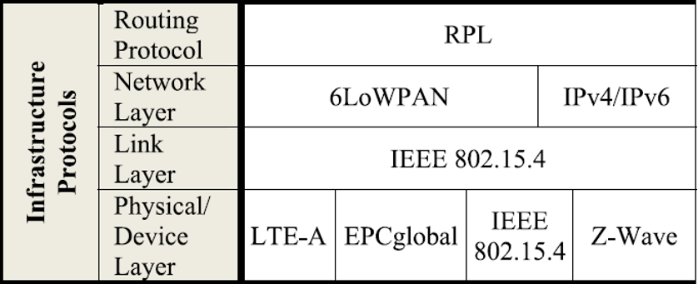
Service Management
Service Management or Middleware (pairing) layer pairs a
service with its requester based on addresses and names. This layer enables the IoT application programmers to work with heterogeneous objects without consideration to a specific hardware platform. Also, this layer processes received data, makes decisions, and delivers the required services over the network wire protocols.

Slide 14
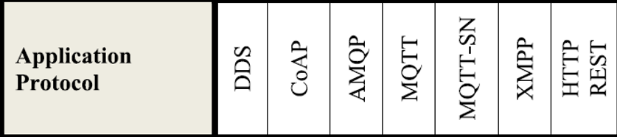
Application Layer
The application layer provides the services requested by
customers. For instance, the application layer can provide temperature and air humidity measurements to the customer who asks for that data. The importance of this layer for the IoT is that it has the ability to provide high-quality smart services to
meet customers’ needs. The application layer covers numerous
vertical markets such as smart home, smart building, transportation,
industrial automation and smart healthcare [3], [17]–[19]

Slide 15
Business Layer
The business (management) layer manages the overall IoT
system activities and services. The responsibilities of this layer are to build a business model, graphs, flowcharts, etc. based on the received data from the Application layer. It is also supposed to design, analyze, implement, evaluate, monitor, and develop IoT system related elements. The Business Layer makes it possible to support decision-making processes based on Big Data analysis. In addition, monitoring and management of the underlying four layers is achieved at this layer. Moreover, this layer compares the output of each layer with the expected output to enhance services and maintain users’ privacy [3], [18].

Slide 16
Exemple

Slide 17
Projet de GERAS
Business Layer
GERAS
Application Layer
Application Layer
Service Management
Infrastructure Layer
Object Absetraction
Objects

Slide 18
Problématique
Comment manipuler les objets d’une manière simple et facile ?
Comment assurer les fonctionnalités de « Business layer» ?
Comment assurer la manipulation des différents objets hétérogènes dans une seule plate-forme ?

Slide 19
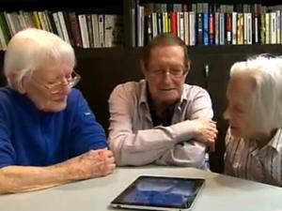
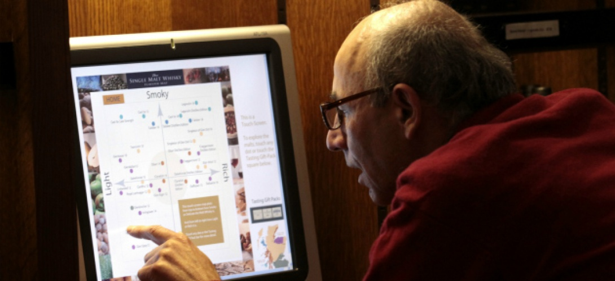
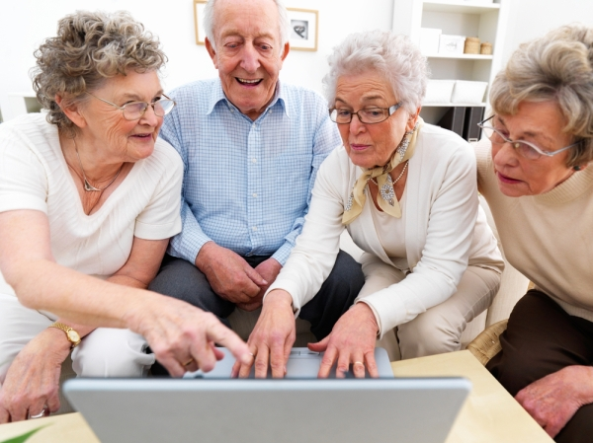
Problématique 1
Comment manipuler les objets d’une manière simple et facile ?
Notes:
Réponse :
* Développer un DSL.

Slide 20
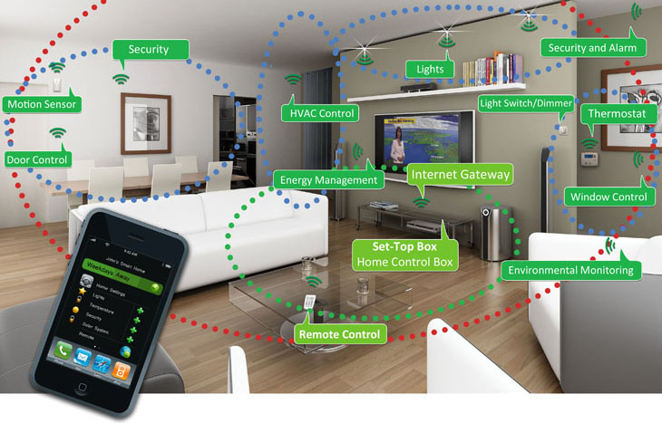
Proposition : Dsl
Proposition : un Dsl textuel / graphique

Slide 21
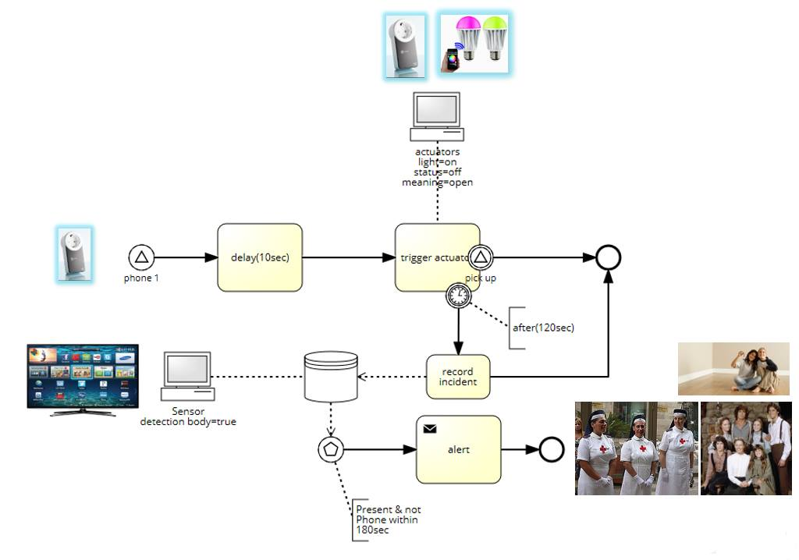
Dsl: Type Declaration
enumeration Volume {V1; V2; V3;}
device Phone{
sensing receiveCall()
actuating ring(volume:Volume)
actuating setVolume(volume: Volume)
sensing pickedUp()
}
device LightBulb{
actuating on()
actuating off()
actuating blink()
}
device Timer{
actuating reset()
actuating set(delay : Volume)
sensing timeout()
}
device AlertDB{
actuating declareIncident(msg:string)
actuating alert()
}
device BodyDetector{
sensing detect()
actuating isPresent()
}
gateway Central

Slide 22
Dsl: Network Configuration
configuration MyHome{
node gw : Central
node entranceBulb : LightBulb
node bathroomBulb : LightBulb
node kitchenBulb : LightBulb
node roomBulb : LightBulb
node ipPhone : Phone
node db : AlertDB
node bodydetector : BodyDetector
node timer : Timer
from entranceBulb to gw via IP
from bathroomBulb to gw via IP
from kitchenBulb to gw via IP
from roomBulb to gw via IP
from ipPhone to gw via IP
}

Slide 23
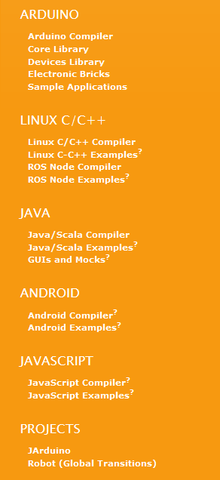
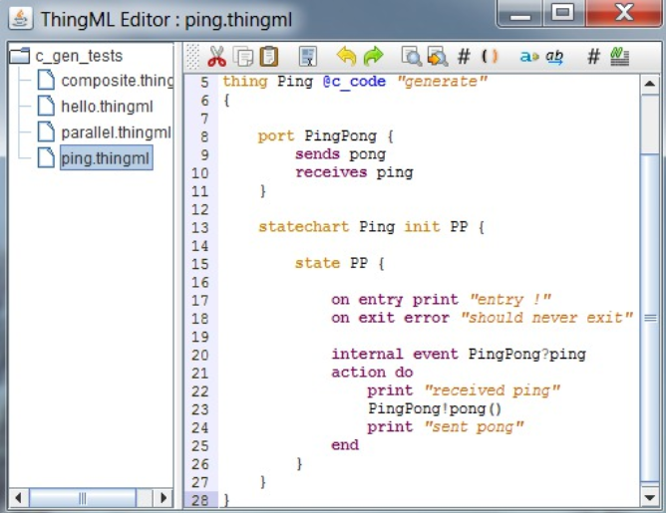
Solution existante: ThingMl

Slide 24
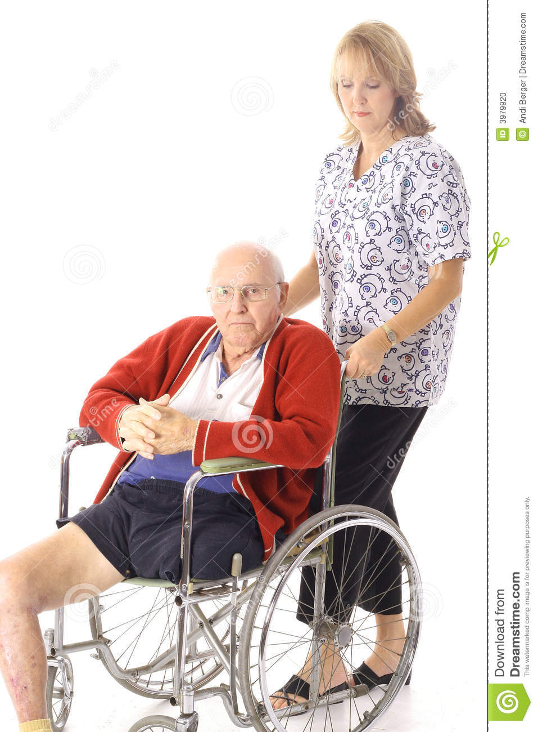
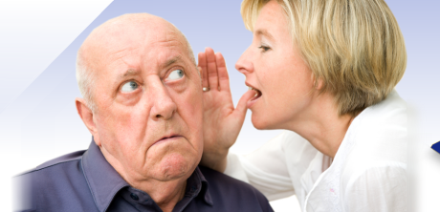

Problématique 2
Comment adapter les fonctionnalités de notre DSL selon le contexte ?

Slide 25
Proposition

Slide 26
Proposition: Business Rules
rule WaitBeforeBlink :
when (ipPhone.ring()) do {
timer.reset()} ; timer.set(10)
}
rule BlinkAndWait:
when (timer.timeout()) do {
LightBulb.blink()
||
(timer.reset() ; timer.set(120))
}
rule PickedUpQuick:
when (ipPhone.pickedUp()) do{
LightBulb.off()
}
rule NotPickedUpAfterBlinking:
when (timer.timeout()) do{
db.declareIncident(predefinedAlert)
||
bodydetector.detect()
||
timer.reset() ; timer.set(60)
}
rule Alert:
when (timer.timeout() and bodydetector.present()) do {
db.alert()
}

Slide 27



Problématique 3
Comment assurer la manipulation des différents objets hétérogènes dans une seule plate-forme ?

Slide 28
Problématique 3

Slide 29
Conclusion

Slide 30
Problématique
La croissance de la taux des personnes plus âgés peut
provoquer plusieurs problèmes :
Problème de mémoire
Problème de mouvement
Problème de prise de médicament.
Well-being of ageing people: independent, active, happy, healthy, safe, …

Slide 31
Proposition
En utilisant la technologie moderne . Est-il possible de régler ce type de problème ?
Solution : IOT

Slide 32
Internet des objets
Des généralités, des définitions.

Slide 33
Exemple

